Slide 1
Application Development for Mobile Devices - About MIDlets and CLDC
Prepared by George Nguyen

Slide 2
Contents
What happens when a MIDlet runs?
Packaging and deploying a MIDlet
Passing properties to MIDlets
MIDlet security
CLDC

Slide 3
What happens when a MIDlet runs?
Application Manager
The Application Manager
device specific software
the environment in which the MIDlet runs
installs MIDlets
runs the MIDlet
calls the MIDlet "life cycle" methods
Java Virtual Machine
MyMIDLet extends MIDlet {
// your code
}
1
2 abc
3 def
4 ghi
5 jkl
6 mno
7 pqrs
8 tuv
9 wxyz
*
0
#
Notes:
The application manager is sometimes software that is pre-installed on the mobile device (i.e. when you buy the device the application manager is already present on it) or it may need to be installed before you can run install and run any MIDlets on the device. For instance, a Zire 72 from PalmOne comes with a piece of software already installed called "Midlet HQ" which installs, manages and runs MIDlets. On the other hand the HP iPAQs that we have bought for student use didn't come with any software installed to deal with MIDlets and so we had to install a version of Midlet HQ from IBM .
The application manager provides the environment in which the Java Virtual Machine (JVM - the program that actually executes the MIDlet instructions) and the MIDlet itself exist.
The application manager creates the instance of the MIDlet (i.e. loads its code into memory and calls its constructor to carry out initialization) and then calls various predefined methods in the MIDlet at important moments in the MIDlets life (birthdays etc .... joke).
As MIDlet programmers we don't need to understand the internals of how the application manager works but we do need to understand how it will interact with our MIDlet. This interaction is specified in the MIDP specification from Sun.

Slide 4
MIDlet lifecycle (1)
Application Manager
public class LifeCycle1 extends MIDlet {
public LifeCycle1() {
System.out.println("I'm being born");
}
protected void startApp() {
System.out.println("I'm being started");
}
protected void pauseApp() {
System.out.println("I'm being paused");
}
protected void destroyApp(boolean param) {
System.out.println("I'm being destroyed - aargh");
}
}
create MIDlet
start MIDlet
pause MIDlet
destroyMIDlet
LIfeCycle1.java
Notes:
NOTE - the only thing missing from this program is an import at the beginning (import javax.microedition.midlet.*; )
When this MIDlet runs in the emulator you'd expect to see:
I'm being born
I'm being started
then sometime later when you exit from it
I'm being destroyed - aargh
The MIDlet's lifecycle methods are: the constructor; startApp(); pauseApp() and destroyApp().
When the MIDlet is to be run the Application Manager creates an instance of it and calls the constructor. The MIDlet is now in the paused state until ....
the Application Manager calls the startApp() method and puts the MIDlet in the active (i.e. running) state.
While the MIDlet is in the active state it can be returned to the paused state (i.e. suspended) by the Application Manager calling the pauseApp() method. Alternatively the MIDlet can put itself in this state by calling the method notifyPaused()
The Application Manager can terminate the MIDlet at any time by calling its destroyApp() method. The MIDlet can choose to destroy itself by calling notifyDestroyed().
Note: You won't see pauseApp() being called after the constructor but you will see that startApp() is called. startApp() is called because initially the midlet is created in a paused state (i.e. unable to respond to events) and is put into the active state by the calling of the startApp() method. So there are two ways a Midlet can go into the paused state: 1) when it is initially created and 2) when it has been active and is then paused. It is only the 2nd of these that will cause the pauseApp() method to be called.

Slide 5
MIDlet lifecycle (2)
constructor
garbage collected
paused state
destroyApp()
destroyed state
startApp()
pauseApp()
destroyApp()
active state
Notes:
Here is the MIDlet lifecycle presented as a state transition diagram.
When the MIDlet is created and the constructor called (by the Application Manager) the MIDlet is put in the paused state. It won't normally stay in this state long as the Application Manager will normally immediately call the startApp() method and put the MIDlet in the active state.
In the active state the MIDlet is running and able to respond to user input. The Application Manager (or the MIDlet itself) may choose at some point to pause the MIDlet by calling the pauseApp() method. For instance some event may happen on the device (e.g. an incoming phone call) that takes precedence over the MIDlet. Once in the paused state the MIDlet can't respond to user events and is effectively suspended.
At some point the Application Manager may choose to restart the MIDlet. In this case stateApp() will be called again and the MIDlet will go back into the active state. Note that during a MIDlet's life the constructor is only called once but startApp() and pauseApp() could be called many times.
All good things must come to an end and eventually the Application Manager or the MIDlet itself will call the destroyApp method to terminate the MIDlet's life. Once in the destroyed state the only thing that can happen to the MIDlet is to be garbage collected which means it is removed from memory.

Slide 6
What to code in the lifecycle methods
Constructor
Code to be executed only once during MIDlet's life
Typically creating elements of the UI e.g. Commands, Screens, Lists etc
startApp()
Code to be executed each time the MIDlet is about to become active. Remember this may be executed more than once during the MIDlet's life.
Typically making the current screen visible
destroyApp()
Releasing resources used by the MIDlet just before shutdown and saving any data (e.g. user preferences)
pauseApp()
Releasing any resources that the MIDlet doesn't need while paused e.g. stopping an animation or closing a network connection
Notes:
Below is an extract from the MIDlet API documentation which explains the role of the boolean flag that is passed to the destroyApp() method.
Note: The MIDlet can request that it not enter the Destroyed state by throwing an MIDletStateChangeException. This is only a valid response if the unconditional flag is set to false. If it is true the MIDlet is assumed to be in the Destroyed state regardless of how this method terminates. If it is not an unconditional request, the MIDlet can signify that it wishes to stay in its current state by throwing the MIDletStateChangeException. This request may be honored and the destroy() method called again at a later time.

Slide 7
Quick Quiz Question 1
Which of the following are true statements?
By the time a MIDlet's constructor has finished executing the MIDlet will be in the active state.
The Application Manager is piece of software written in Java that you download from Sun if you want to run MIDlets on a portable device.
A possible sequence of calls to a MIDlet's lifecycle methods is: constructor, startApp(), pauseApp(), startApp(), destroyApp()
Notes:
False, it’s in the paused state until the startApp() is called by the application manager
False, it is a device-specific piece of software that provides the environment for the JVM and the Midlets
True

Slide 8
Contents
What happens when a MIDlet runs?
Packaging and deploying a MIDlet
Passing properties to MIDlets
MIDlet security
CLDC

Slide 9
Packaging and deploying a MIDlet
compile
preverify
test on emulator
convert to device specific format e.g. to the Palm Resource (prc) Format
over the air (OTA) provisioning
web server
package the MIDlet suite
Notes:
However the MIDlet is to be deployed it normally needs to be packaged as a "MIDlet suite" - see next slide. It can then either be deployed using the standard method specified by Sun which is called Over the Air Provisioning (OTA) or in some device specific manner.

Slide 10
Packaging the MIDlet suite
MIDlets are deployed in MIDlet suites
A MIDlet suite is a collection of MIDlets plus configuration information
It consists of:
an application descriptor (a JAD file)
a JAR file containing the MIDlet .class file(s) and a manifest file
MIDlet suite
MyMidletSuite.jar
MyMidletSuite.jad
MyMidlet.class
MANIFEST.MF
Notes:
The packaging of MIDlets into a MIDlet suite is handled quite nicely for you by the Java WTK and NetBeans and so you don’t have to worry too much about the details.
The JAD file is a text file (could create it with Notepad if you wanted to) which contains information about the MIDlet suite including the size of the jar file. The JAD file is a separate file so that the application manager on the device can have a look at it and use the information in it (jar file size, author, cost etc) to decide whether or not to download the (potentially large) jar file onto the device.
JAR stands for Java ARchive file and is a standard file format (based on the ZIP compression format) in which various types of Java programs (Applets, servlets etc) are deployed. All JAR files need to contain a file called MANIFEST.MF which goes in a directory within the JAR file called META-INF. The MANIFEST.MF is a very simple text file.
The JAD and MANIFEST.MF files are generated for you by the Java WTK and NetBeans which also generates the JAR file and puts your class file(s) and manifest file into it.

Slide 11
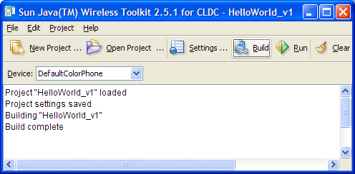
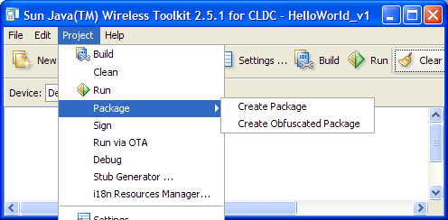
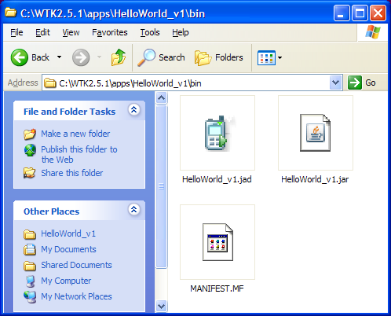
Packaging a MIDlet suite with Java WTK
Notes:
Having built (and tested!) your MIDlet you can package it using Project->Create Package. This will create a JAD and JAR file in your application bin directory.
If you need to manually set any of the information that goes in the JAD file (e.g. to specify an icon to be used for your MIDlet) you can do this via the "Settings" option.

Slide 12
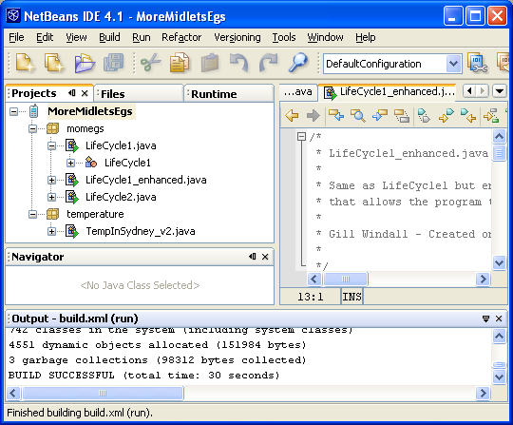
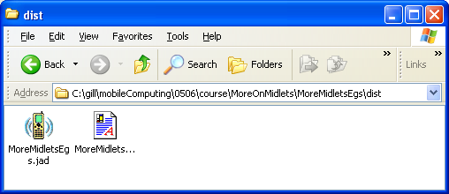
Packaging a MIDlet suite with NetBeans
Even easier
Just creating and building a MIDlet project creates a MIDlet suite, puts all MIDlets in the project/suite in a JAR and creates a JAD

Slide 13
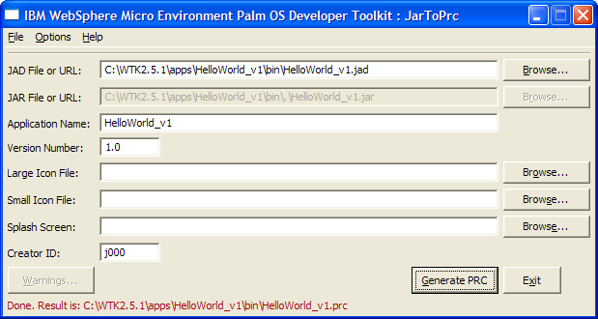
Converting to PRC format
PRC (Palm ResourCe) is a format that allows MIDlets to be installed on PalmOS devices like native PalmOS applications
The IBM WebSphere Micro Environment Palm OS Developer ToolKit Jar to PRC tool will create a PRC file from a JAD/JAR file
Notes:
IBM WebSphere Micro Environment Palm OS Developer ToolKit can be downloaded free from http://www.palmone.com/us/support/jvm/download.html
PRC stands for Palm ResourCe format
Note that Java MIDlets don’t have to be converted to PRC format to be installed on a Palm device if you are going to use OTA provisioning, only if your want to deploy them using the same mechanism by which other software (Java and non-Java) is installed.

Slide 14
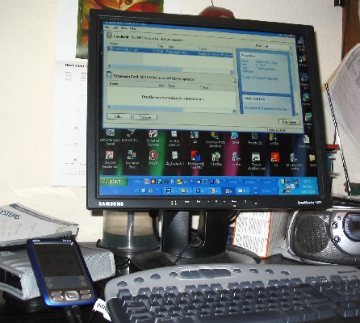
Installing PRC on PalmOS device
Use the standard Palm Quick Install application from a PC
drag and drop the PRC into the Quick Install application on the PC
Hotsync from the PalmOS device
Notes:
Alternatively the PRC file can be downloaded from a web server.

Slide 15
Installing via OTA provisioning
Over The Air Provisioning (OTA) is a Java ME standard for distributing applications to wireless devices that don't necessarily have the ability to synchronise with a desktop PC
Instead of a PRC (or other device specific format) file, the JAR and JAD files are downloaded directly
The Java Application Manager on the device can carry out security checks including verification of signed MIDlets
Notes:
The following is copied from "MIDlet Packaging Options for palmOne Handhelds", February 24, 2004 from www.palmone.com/java
The decision to provide your Java application for palmOne devices in either a
PRC or JAD+JAR format comes down to a few factors. First, if you are looking to
target both palmOne devices, as well as other J2ME handsets, you will
absolutely have to provide your application in the JAD+JAR format. Other J2ME
devices do not support the PRC format. Second, if you only provide your
application JAD+JAR format, your users will only be able to install their
applications on their wireless device directly through the web browsers, which
mobile handsets users may be used to, but most Palm OS devices users are not.
For that reason, you may choose to provide the application both in the JAD+JAR
format and the PRC format, though the PRC version of the application won’t
benefit from the trust system provided by the Java Application Manager. Finally,
if you want your Java application to look and act as much like a native Palm OS
application as possible, and have no plans to target other J2ME mobile handsets,
then you should just distribute your application in PRC format.

Slide 16
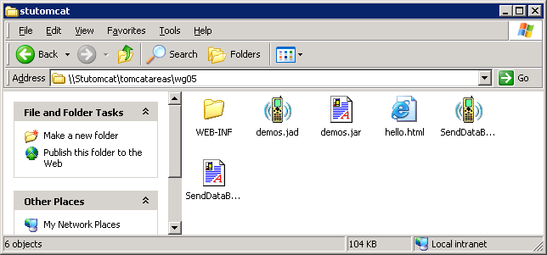
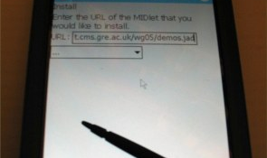
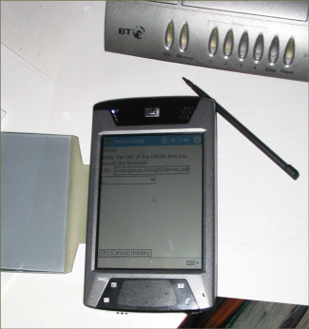
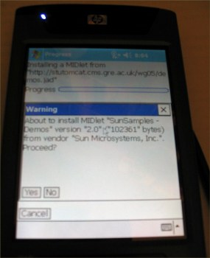
Example of OTA deployment
1
2
3
Notes:
1. Put the JAR and JAD file somewhere on a web server. Here I've put them into my area or the student Tomcat server at Greenwich (\\Stutomcat\tomcatareas\wg05) which is at the URL http://stutomcat.cms.gre.ac.uk/wg05.
2. Connect your mobile device to the Internet. Here it is one of the HP iPAQs owned by the University connected via Wi-Fi using a wireless access point in my home. Using a mobile phone you might connect using the cell phone network (i.e. GSM, GPRS or 3G network).
3. Access the JAD file by entering the URL (e.g. http://stutomcat.cms.gre.ac.uk/wg05/demos.jad). You could enter the URL directly into a screen provided by the application manager as shown here or you could surf to a web page using a web browser containing a link to the JAD file. In either case the application manager will download and read the JAD file and on the basis of the information contained in it decide whether to download and install the JAR file. The exact messages and prompts that appear on screen will depend on the application manager software. Eventually the MIDlet should be installed on the device and be able to be run.

Slide 17
Contents
What happens when a MIDlet runs?
Packaging and deploying a MIDlet
Passing properties to MIDlets
MIDlet security
CLDC

Slide 18
Passing properties to MIDlets
One use you can make of the JAD file or the JAR manifest is to pass parameter information to the MIDlet
This allows you to change the MIDlet's behaviour without having to change or recompile its code.
HTTP GET
"what's the weather like in Paris France"
WeatherInSydney MIDlet
JAD file
city: paris
country: france
www.webservicex.net web server
Notes:
You probably wouldn't use it in this case. More likely you'd use it to set information such as the address of the server to get information from or maybe the language to use for the user interface i.e. the sort of information you'd normally put in a configuration file.

Slide 19
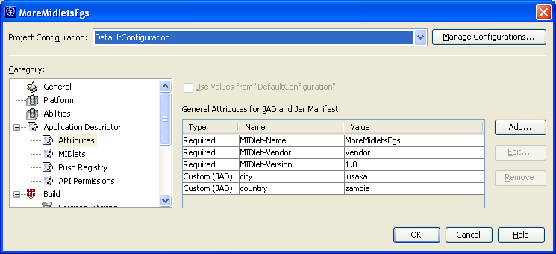
Setting and retrieving properties
Extract from MIDlet code
private String city = "sydney";
private String country ="australia";
public TempInSydney_v2() {
…….
city = getAppProperty("city");
country = getAppProperty("country");
}
JAD file
MIDlet-1: TempInSydney, , temperature.TempInSydney_v2
MIDlet-Jar-Size: 100
MIDlet-Jar-URL: MoreMidletsEgs.jar
MIDlet-Name: MoreMidletsEgs
MIDlet-Vendor: Unknown
MIDlet-Version: 1.0
MicroEdition-Configuration: CLDC-1.1
MicroEdition-Profile: MIDP-2.0
city: lusaka
country: zambia
Notes:
In the Wireless toolkit it is Project->Settings->User Defined
in NetBeans right-click the project then Properties->Application Descriptor->Attributes
Should the properties go in the manifest or the JAD? In the JAD certainly. Some platforms may pick up the properties from the manifest but all I've tested pick them up from the JAD.
In real life for this particular application it would be nicer for the user if they could select the location from a list but in certain applications it can be useful to set parameters in this way.

Slide 20
Contents
What happens when a MIDlet runs?
Packaging and deploying a MIDlet
Passing properties to MIDlets
MIDlet security
CLDC

Slide 21
Who's concerned about wireless application security?
Carriers
viruses might crash their networks
Device manufacturers
third party software might crash their devices
Users
device might crash
personal information might be stolen or corrupted
might incur unexpected charges

Slide 22
Java's basic security
Memory access for the Java program is restricted to areas of memory allocated to Java
Device
Java Virtual Machine
Malicious Java Program
Malicious binary Program
Notes:
Java code runs within the Java Virtual Machine and this provides a layer of protection between a potentially malicious Java program and the resources of the device itself. For instance memory access for Java program will be restricted to areas of memory allocated to Java. A Java program won't be able to break out of that. A binary program (e.g. compiled C++) has no such level of protection and so could potentially access any of the resources belonging to the device.
This is a rather simplistic view but it gives an idea of the "built-in" protection that come with Java whatever the platform.
What about .Net CF programs? They too run in a "managed environment". Instead of the JVM we have the CLR (Common Language Runtime). Like the JVM this should protect the underlying device and resources from malicious code BUT because the CLR is more closely integrated with the underlying OS than the JVM (remember .Net CF only runs on Windows) there is perhaps more potential for malicious code to access device resources.

Slide 23
MIDP 1.0 and MIDP 2.0 security
MIDP 1.0 has only basic Java security
MIDP 2.0 specifies a security architecture
HTTPS support is mandatory
permissions needed for performing sensitive operations e.g. make a HTTP connection
protection domains to which MIDlets can belong
permissions attributes - MIDlets can specify what permissions they need in the JAD file
Notes:
The MIDP 2.0 framework provides for the specification of any number of protection domains. Permissions are assigned to domains. Permissions may be of two types: allowed permissions (things the MIDlets in that domain are automatically allowed to do) and user permissions (things the user must be prompted for).
MIDlets are allocated to protection domains based on specified rules (e.g. MIDlets from certain websites may be put in a trusted protection domain).
MIDlets can have MIDlet-Permissions attributes specified in the JAD file. These may specific for instance that a particular MIDlet absolutely has to have certain permissions in order to run. The Application Manager can check these before installing the MIDlet and if there is a conflict between what the MIDlet needs and what permissions the MIDlet will be granted given its protection domain it may decide not to install the MIDlet.
This may all sound a bit vague but this is because the MIDP specification only sets down a security framework; many details of how it is implemented is up to the MIDP implementation.

Slide 24
Example of protection domains and permissions
Trusted protection domain
Criteria:
All MIDlets from www.trustme.com
All signed MIDlets
Permissions
all permissions
Untrusted protection domain
Criteria
All other MIDlets
Permissions
user to be asked for permissions
oneshot
session
blanket
Minimum protection domain
Criteria
All MIDlets from www.evilMIDlets.com
Permisions
denied all permissions
Notes:
This side shows the three protection domains implemented on the Wireless Toolkit. The protection domains implemented on a particular device may be different.
When a MIDlet is installed on the device it is assigned to one or other protection domain depending on the criteria specified for the domains. For instance in the example above a MIDlet from www.evilMIDlets.com will be assigned to "Minimum protection domain".
The protection domain that the MIDlet is placed in determines what permissions it is allowed. For instance, in the example above a MIDlet in the "Trusted protection domain" will have all permissions without having to ask for them. Permissions can be more finely grained than the ones shows above. For instance, in a particular domain you may allow HTTP connections but require the user to give explicit permission for the sending of SMS messages.
User permissions are further classified as oneshot, session and blanket. These related to how long the permission lasts once granted by the user:
oneshot - just lasts for that request. If the MIDlet needs the same permission even a few seconds later then it must ask again
session - the permission lasts all the time the MIDlet is running
blanket - the permission lasts until this particular MIDlet suite is uninstalled.

Slide 25
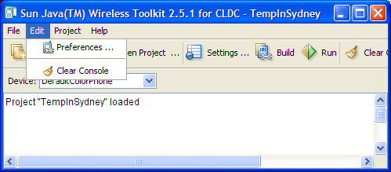
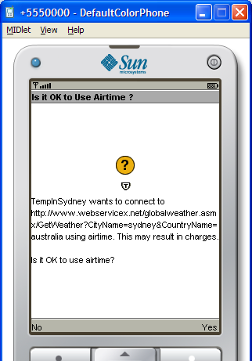
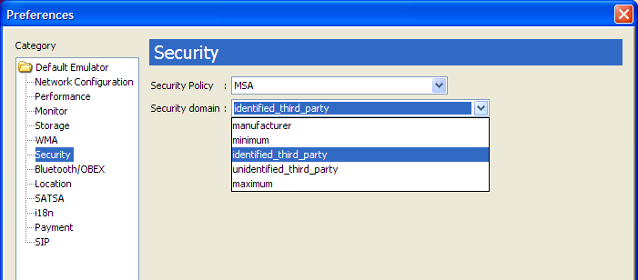
Security example using Java WTK
Notes:
The default security setting in the Java WTK 2.5.1 is MSA – unidentified_third_party. If you run the TempInSydney example using this domain you will get prompted about whether or not you wish it to be allowed to make a network connection. If you change the permissions in "Preferences" to allocate the MIDlet to the “maximum" security domain then you will not be prompted and the MIDlet will be automatically given permission to make a network connection.
To experiment with this in Netbeans you right-click the project and select properties. Then select Platform and click the "Manage Emulators" button. The select the "Tools & Extensions" then click "Open Preferences". Then choose the Security tab. You can then change the security domain from the drop down box.

Slide 26
Pause for thought
Why is it useful to be able to specify the permissions required by a MIDlet in the JAD file?
Notes:
It's a handy way to advise a device at installation time that your MIDlet suite will be attempting particular operations. If the device is about to install the MIDlet suite into a protection domain that doesn't allow some of the permissions the MIDlet suite requires, the installation can fail gracefully. Without this mechanism, the user could install a MIDlet suite only to find later that it doesn't work.

Slide 27
Contents
What happens when a MIDlet runs?
Packaging and deploying a MIDlet
Passing properties to MIDlets
MIDlet security
CLDC

Slide 28
Where the CLDC sits
MIDP
Mobile Information Device Profile
Personal Profile
Personal Basis Profile
Information Module
Foundation Profile
CLDC
Connected Limited Device Configuration
CDC
Connected Device Configuration
J2ME
Notes:
So as a MIDP programmer you are mainly working with the MIDP and CLDC APIs. MIDP - new stuff specifically for mobile devices. CLDC - cut-down versions of old stuff. Not quite that simple but close.
The Information Module is a Profile that supports devices without rich graphical displays e.g. devices embedded in others such as vending machines.

Slide 29
What is the CLDC?
Basically a stripped-down version of the core Java SE APIs
java.io
java.lang
java.util
javax.microedition.io
CLDC version 1.0 (2000)
No floating point arithmetic
CLDC version 1.1 (2003)
Floating point restored + a few other features missing from CDLC 1.0
Notes:
Early implementations of MIDP 2.0 were implemented on top of CLDC 1.0 because MIDP 2.0 came out before CLDC 1.1. Now that CLDC 1.1 is available it is likely to be implemented on most platforms. Though looking through some specs of mobile phones that is not necessarily the case and there are still a number of CLDC 1.0 devices on the market.

Slide 30
Some differences between CLDC 1.1 and Java SE
No object finalization
No reflection
No programmer access to native methods
Simpler threading
Fewer methods in the Math class
No System.in
No file classes in java.io
Far fewer collection classes in java.util e.g. no ArrayList, HashMaps, TreeSets etc
Does not support features introduced with Java 5.0 such as for-each loops, generics etc
Notes:
Of course this only really makes sense to someone who knows the Java SE fairly well. The overall message is that you shouldn't expect something to exist in the CLDC just because it exists in Java SE so check before you design your application.
Although there are no file classes there is a new package in MIDP that allows you to store data - javax.microedition.rms

Slide 31
Summary
When a MIDlet runs it is loaded by a piece of software called the Application Manager which then calls its methods at appropriate times
In order to be deployed MIDlets are packaged in MIDlet suites consisting of an application descriptor (a JAD file) and all other files needed in a JAR.
Properties can be set in the JAD file which are passed at run time to the MIDlet
MIDP 2.0 specifies a relatively sophisticated security architecture.
MIDP sits on top of the CLDC which is like a cut-down version of core Java APIs

Slide 32
Reading
Read "Understanding MIDP 2.0's Security Architecture" by Knudsen at http://developers.sun.com/techtopics/mobility/midp/articles/permissions/
If you have the book then read "Beginning Java ME Platform (Expert’s Voice in Open Source)", 2008 by Ray Rischpater. Chapters 3 and 4.

